Slide 1
Introduction to COCOMO models
The COstructive COst Model (COCOMO) is the most widely used software estimation model.
The COCOMO model predicts the effort and duration of a project based on inputs relating to the size of the resulting systems and a number of "cost drives" that affect productivity.

Slide 2
COCOMO Models
COCOMO is defined in terms of three different models:
the Basic model,
the Intermediate model, and
the Detailed model.
The more complex models account for more factors that influence software projects, and make more accurate estimates.

Slide 3
The Development mode
The most important factors contributing to a project's duration and cost is the Development Mode
Organic Mode: The project is developed in a familiar, stable environment, and the product is similar to previously developed products. The product is relatively small, and requires little innovation.
Semidetached Mode: The project's characteristics are intermediate between Organic and Embedded.
Embedded Mode: The project is characterized by tight, inflexible constraints and interface requirements. An embedded mode project will require a great deal of innovation.

Slide 4
Modes

Slide 5
Effort Computation
The Basic COCOMO model computes effort as a function of program size. The Basic COCOMO equation is:
E = aKLOC^b
Effort for three modes of Basic COCOMO.
Mode | a | b
Organic | 2.4 | 1.05
Semi-detached | 3.0 | 1.12
Embedded | 3.6 | 1.20

Slide 6

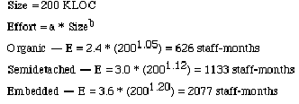
Example

Slide 7
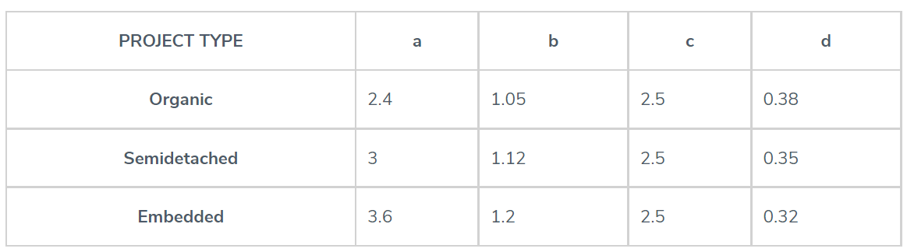
Basic COCOMO
For 300 KLOC,
Organic E = 2.4*(300)^1.05= 958 Man-Month
Semi-detached E=3*(300)^1.12=1785 Man-Month
Embedded E=3.6*(300)^1.2=3380 Man –Month
Time Duration D= c*(E) ^d
Organic D=2.5*(958) ^ 0.38=34 Months
Semi-detached D=2.5*(1785) ^ 0.35= 34 Months
Embedded D=2.5*(3380) ^0.32=34 Months
Average Resource Size=E/D
=958/34
=28 Man

Slide 8
Effort Computation
The intermediate COCOMO model computes effort as a function of program size and a set of cost drivers. The Intermediate COCOMO equation is:
E = aKLOC^b*EAF
Effort for three modes of intermediate COCOMO.
Mode | a | b
Organic | 3.2 | 1.05
Semi-detached | 3.0 | 1.12
Embedded | 2.8 | 1.20

Slide 9
Effort computation(.)
Effort Adjustment Factor
Cost Driver
Very
Low
Low
Nominal
High
Very
High
Extra
High
Required Reliability
.75
.88
1.00
1.15
1.40
1.40
Database Size
.94
.94
1.00
1.08
1.16
1.16
Product Complexity
.70
.85
1.00
1.15
1.30
1.65
Execution Time Constraint
1.00
1.00
1.00
1.11
1.30
1.66
Main Storage Constraint
1.00
1.00
1.00
1.06
1.21
1.56
Virtual Machine Volatility
.87
.87
1.00
1.15
1.30
1.30
Comp Turn Around Time
.87
.87
1.00
1.07
1.15
1.15
Analyst Capability
1.46
1.19
1.00
.86
.71
.71
Application Experience
1.29
1.13
1.00
.91
.82
.82
Programmers Capability
1.42
1.17
1.00
.86
.70
.70
Virtual machine Experience
1.21
1.10
1.00
.90
.90
.90
Language Experience
1.14
1.07
1.00
.95
.95
.95
Modern Prog Practices
1.24
1.10
1.00
.91
.82
.82
SW Tools
1.24
1.10
1.00
.91
.83
.83
Required Dev Schedule
1.23
1.08
1.00
1.04
1.10
1,10

Slide 10
Effort Computation (..)
Total EAF = Product of the selected factors
Adjusted value of Effort: Adjusted Person Months:
APM = (Total EAF) * PM

Slide 11


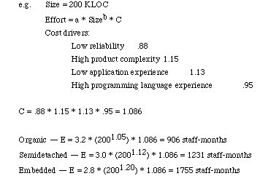
Example

Slide 12
Software Development Time
Development Time Equation Parameter Table:
Development Time, TDEV = C * (E)^D
Number of Personnel, NP = E / TDEV
Parameter | Organic | Semi-detached | Embedded
C | 2.5 | 2.5 | 2.5
D | 0.38 | 0.35 | 0.32

Slide 13
E = a*(KLOC)^b*EAF
D=c*(E) )^d
For a given project was estimated with a size of 300 KLOC. Calculate the Effort, Scheduled time for development by considering developer having high application experience and very low experience in programming.
EAF=0.42*0.91=1.29
E=2.4*(300) ^1.05 *1.29= 1235 Man-Month
D= 2.5*(1235) ^0.38= 37 Months

